Slide 1


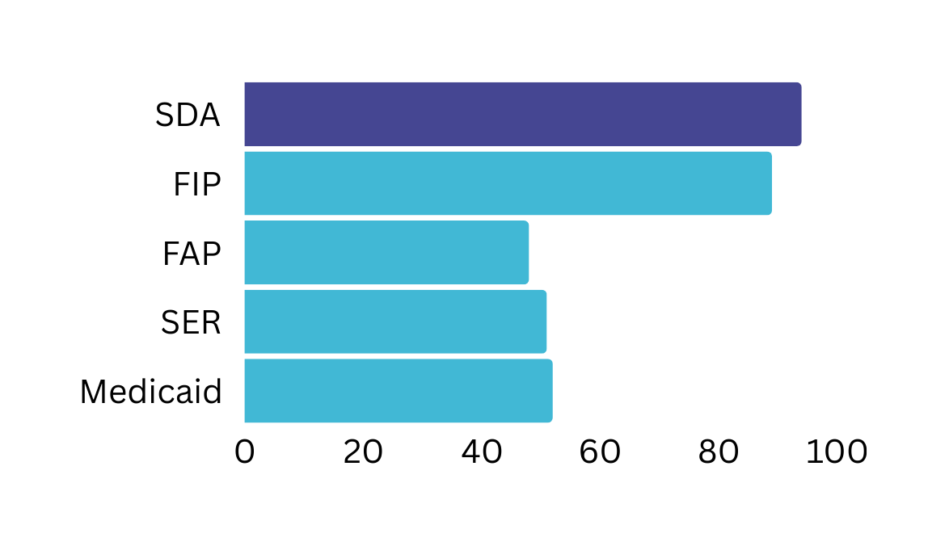



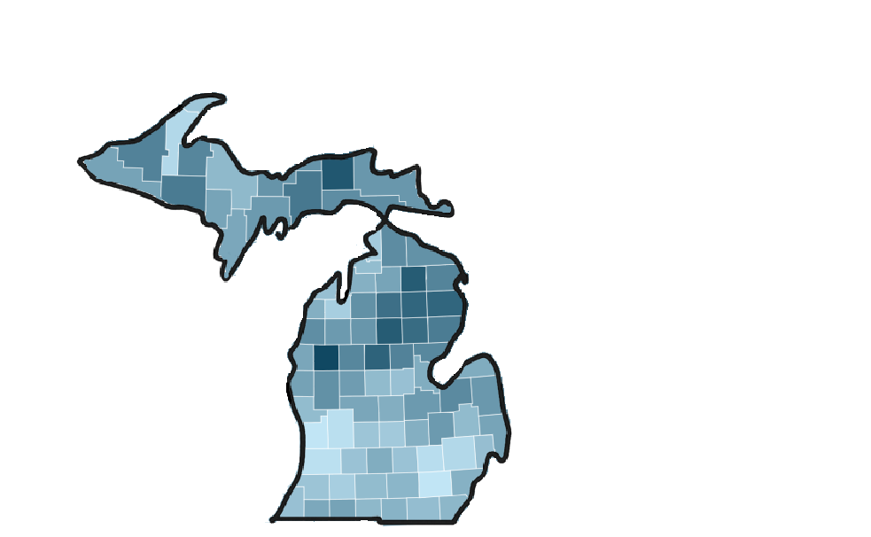
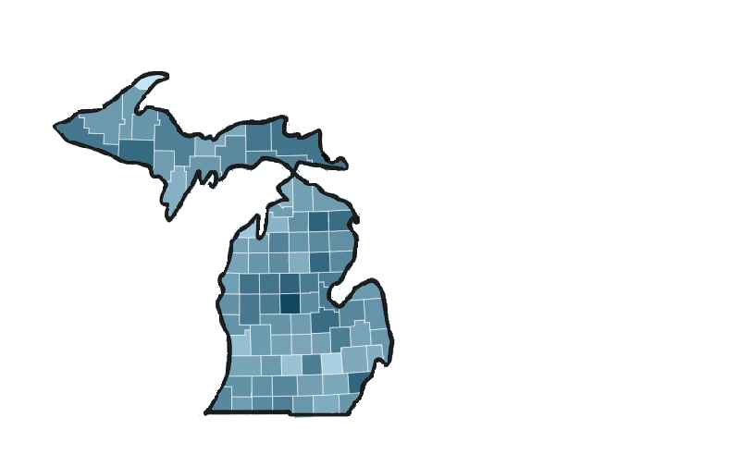
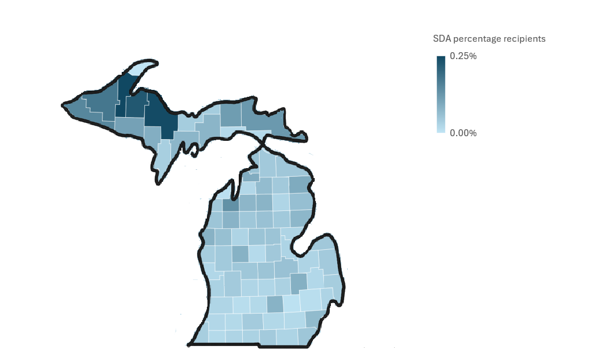
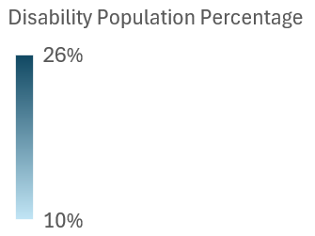
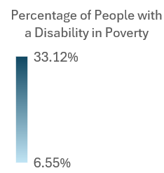
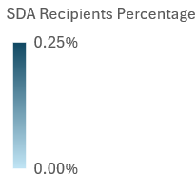




A Deep Dive Into Michigan’s State Disability Assistance Program (SDA) and Social Security Disability Insurance (SSDI): A Program That Rejects Its Own Constituents
Liz Armstrong | Master of Public Policy Program | Michigan State University
SSDI
SDA
SDA and SSDI Rejection Issues
SDA Is Not Alleviating Poverty
Location Affects Benefits
1.7 million
people applied for SSDI in 2022
A 1-point increase in the disability poverty rate is associated with an SDA enrollment increase of 0.25 recipients per 10,000 people
There are 3.47 more SDA recipients per 10,000 people in micropolitan counties (10,000-49,999 pop. ) than in metropolitan counties
  Federally operated
  State operated
70%
of people who applied were rejected
High-poverty counties receive 39% more funding counties per 100,000 residents compared to low-poverty counties, regardless of size
  Cash Benefit
  Cash Benefit
50,000
people applied for SDA in 2022
  Funded through payroll tax
  Funded by state general fund
94%
are rejected
  Meant for workers who become disabled
  Meant for anyone with a disability
SDA outpaces other state program denial rates
55 counties under 100,000 people, residents receive 11¢ less in benefits compared to counties with 100,000 people or more
  Asset limit of $15,000; $200,000 with property
94%
  No asset limits
89%
The disability poverty rate is about 2x Michigan’s poverty
21%
13%
  Average benefit is $1,568
  Average benefit for domicile care is $990 and $1,050 for personal care
48%
Methodology
51%
SDA Capacity Is Overburdened
  Benefits begin after 6 months (wait times vary)
52%
For every additional disabled resident, there are an additional 2.35 denials per 10,000 people
For this project, I collected county data from the American Community Survey, NIH HDPulse, and the Michigan State Bar website from 2022. I also obtained 2022 data from the Social Security Administration and Michigan’s Health and Human Services Department.
  Medicare after 2 yrs of receiving benefits
  Benefits begin after 90 days
For every 10 denials per 10,000 people, disability poverty rate is 1.13 percentage points higher
Each 1% increase in residents with bachelor’s degrees is associated with 0.49 fewer denials per 10,000 people
  No health insurance
Policy Reform Makes An Impact
Policy Recommendations
Policy Change
Impact
  Priority #1: Approve more SDA applications to reduce poverty in counties. This can be done by increasing the asset limit/eliminating the property limit
  Priority #2: Concentrate resources towards metropolitan counties to reduce disability unemployment and poverty
  Priority #3: Increase SDA benefits/ capacity as they are rigid and are not enough to lift individuals/families out of poverty
  Priority #4: Create a centralized database for the SDA Program to measure its effects and influence
The true measure of any society can be found in how it treats its most vulnerable members. –Mahatma Gandhi
Reduce denials 50/10k
Poverty 5.35 points
Cut disability unemployment by 1%
Poverty 0.55 points
Raise disability income by $4,000
Poverty 1.00 point
SDA and SSDI’s Limited Reach To Recipients

